Slide 1
Object Diagram

Slide 2
Object Diagram
An object diagram is a snapshot of the objects in a System at a point in time .
It Shows instances rather than classes,
An object diagram is often called an instance diagram .

Slide 3
When to Use Object Diagram
Object diagrams are useful for showing examples of objects connected together.
In many situations, you can define a structure precisely with a class diagram, but the structure is still difficult to understand .
In these situations, a couple of object diagram examples can make all the difference .

Slide 4
Purpose of Object Diagram
The use of object diagrams is fairly limited, mainly to show examples of data structures.
During the analysis phase of a project, you might create a class diagram to describe the structure of a system and then create a set of object diagrams as test cases to verify the accuracy and completeness of the class diagram.
Before you create a class diagram, you might create an object diagram to discover facts about specific model elements and their links, or to illustrate specific examples of the classifiers that are required.

Slide 5

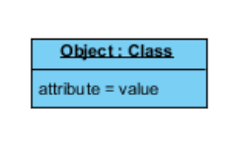
Basic Notations
Object Name
Every object is actually symbolized like a rectangle, that offers the name from the object and its class underlined as well as divided with a colon.
Object Attributes:
Object attributes are inside a separate compartment.
However, unlike classes, object attributes should have values assigned for them.

Slide 6
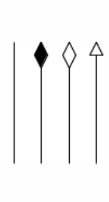
Basic Notation
Links
Links tend to be instances associated with associations. You can draw a link while using the lines utilized in class diagrams.

Slide 7
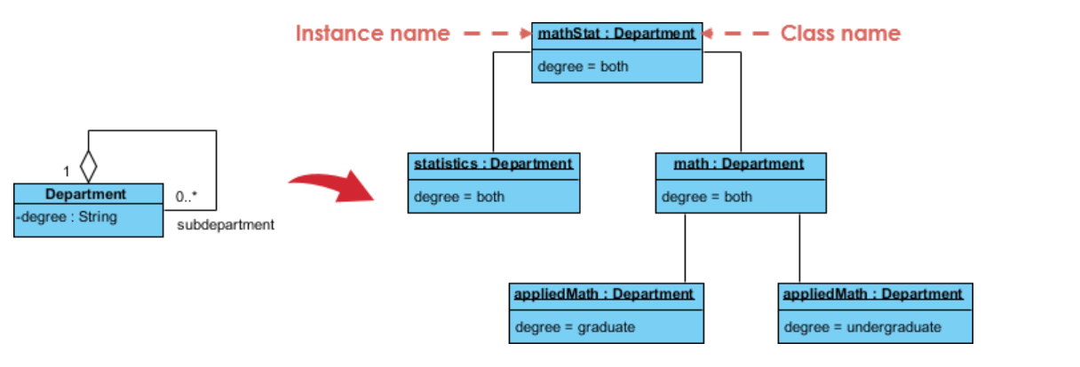
Class & Object Diagram

Slide 8
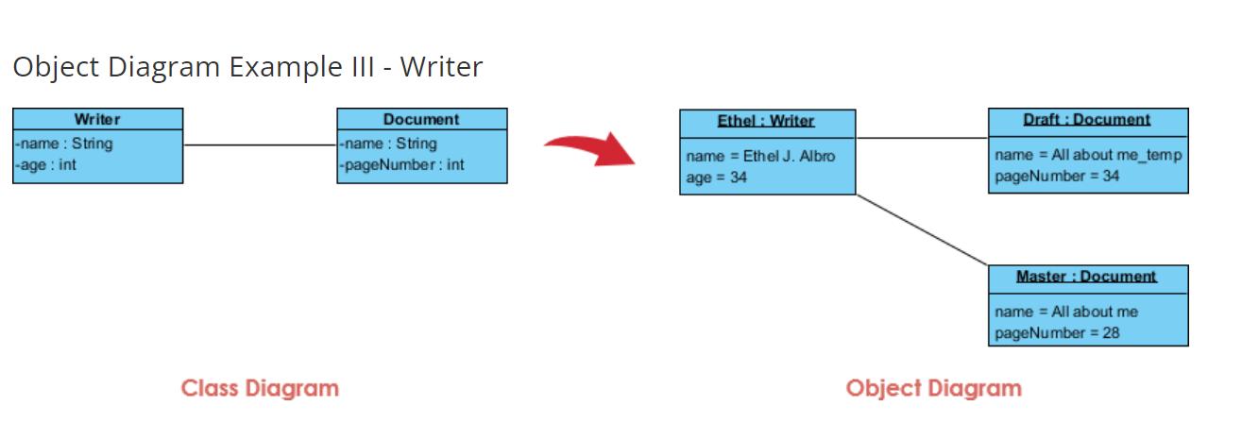

Slide 9
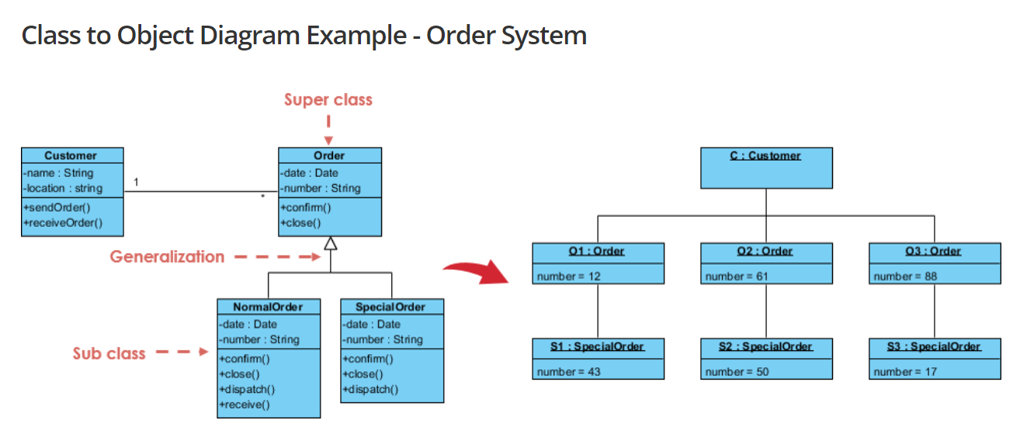
Class to Object Diagram

Slide 10
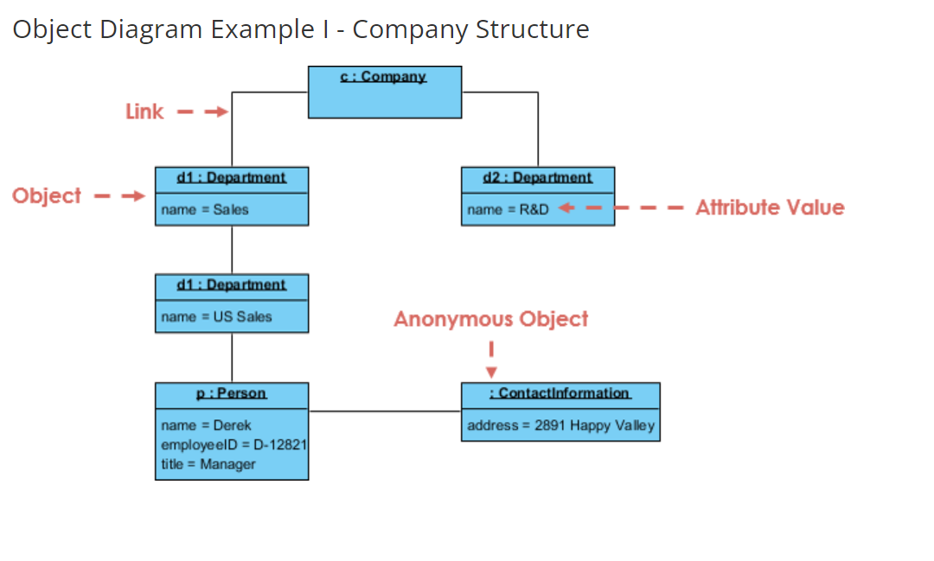

Slide 11
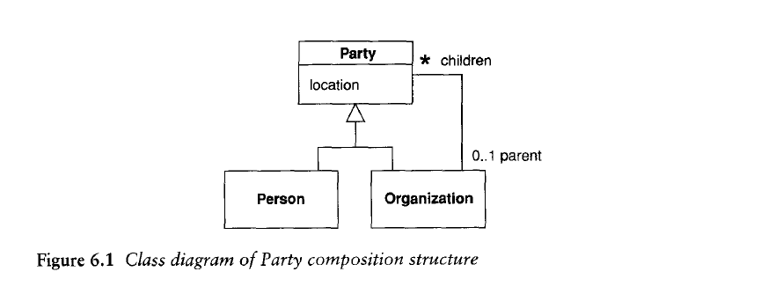

Slide 12
